Slide 1

Databases
By: Manoja Weerasekara

Slide 2
SQL-Session 3

Slide 3
Filter Data: Where
Used to filter records.
It is used to extract only the records that fulfill a specified condition.
It is mostly used in statements like:
–SELECT
–UPDATE
–DELETE
SELECT field1, field2,...fieldN
FROM table_name1, table_name2...
[WHERE Clause]

Slide 4
Select the records which satisfy a condition with all the fields of the table:
SELECT * FROM <Table_Name>
WHERE <Condition>;
Select the records which satisfy a condition with specific fields in a table:
SELECT <Field names>
FROM <Table_Name>
WHERE <Condition>;

Slide 5
Basic SELECT statements with Operators:
Arithmetic Operators
Comparison/Relational Operator
Logical Operator

Slide 6
Using arithmetic operators in SQL statements
SQL commands are often used in conjunction with arithmetic operators.
As you perform mathematical operations on attributes, remember the rules of precedence.
1. Perform operations within parentheses
2. Perform power operations
3. Perform multiplications and divisions
4. Perform additions and subtractions

Slide 7
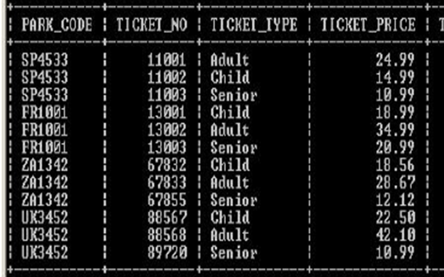

Slide 8
Suppose the owners of all the theme parks wanted to compare the current ticket prices, with an increase in the price of each ticket by 10% .
You’re required to show all the ticket details in the Ticket table.

Slide 9
SELECT PARK_CODE, TICKET_NO, TICKET_TYPE, TICKET_PRICE,
TICKET_PRICE + ROUND((TICKET_PRICE *0.1),2)
FROM TICKET;

Slide 10
SELECT PARK_CODE, TICKET_NO, TICKET_TYPE, TICKET_PRICE, TICKET_PRICE + ROUND((TICKET_PRICE *0.1),2) PRICE_INCREASE
FROM TICKET;
or
SELECT PARK_CODE, TICKET_NO, TICKET_TYPE, TICKET_PRICE, TICKET_PRICE + ROUND((TICKET_PRICE *0.1),2) AS
“PRICE INCREASE”
FROM TICKET;

Slide 11
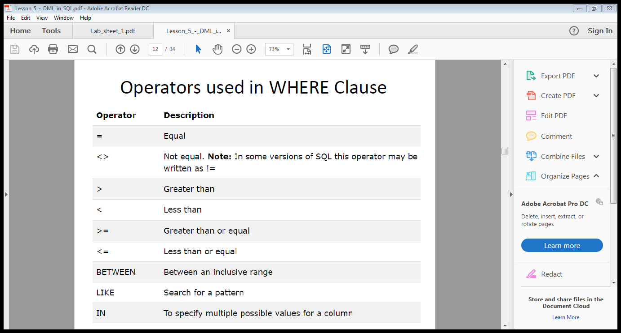
Comparison Operators

Slide 12
SELECT * from Book
WHERE book_author = ‘Elmasri';
How to select book id of the book written by Elmasri

Slide 13
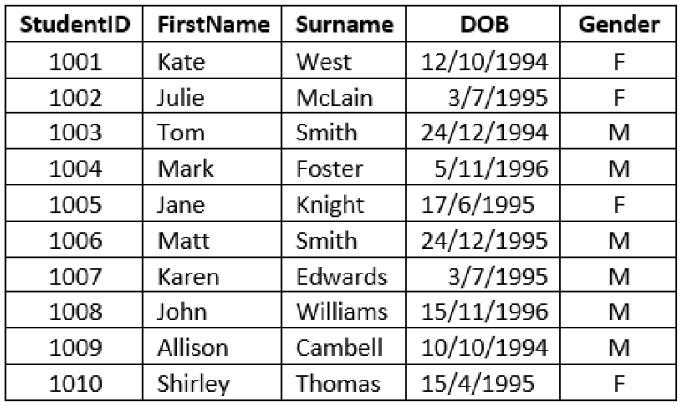

Slide 14
Display all the details of female students.
Display ID and first name of all students whose surname is Smith.

Slide 15
Next:
Display the theme park code, ticket price and ticket type of all tickets where the ticket price is greater than 20.00

Slide 16
SELECT PARK_CODE, TICKET_TYPE, TICKET_PRICE
FROM TICKET
WHERE TICKET_PRICE > 20;

Slide 17
Next: if you want to see a listing for all tickets whose prices are between €30 and €50.
What is the operator that we can use?

Slide 18
The operator BETWEEN may be used to check whether an attribute value is within a range of values.
SELECT *
FROM TICKET
WHERE TICKET_PRICE BETWEEN 30.00 AND 50.00;

Slide 19
Select all customers that are located in "Germany", "France" and "UK":
Select all customers that are NOT located in "Germany", "France" or "UK":

Slide 20
SELECT * FROM Customers WHERE Country IN ('Germany', 'France', 'UK');
SELECT * FROM Customers WHERE Country NOT IN ('Germany', 'France', 'UK');

Slide 21
Logical Operators :
SQL allows you to have multiple conditions in a query through the use of logical operators: AND, OR and NOT.
NOT has the highest precedence, followed by AND, and then followed by OR.
However, you are strongly recommended to use parentheses to clarify the intended meaning of the query.

Slide 22
Logical Operator : AND
This logical AND connective is used to set up a query where there are two conditions which must be met for the query to return the required row(s)
Syntax: AND , &&
Exercise:
Write a query to display the employee number (EMP_NUM) and the attraction number (ATTRACT_NUM) for which the numbers of hours worked (HOURS_PER_ATTRACT) by the employee is greater than 3 and the date worked (DATE_WORKED) is after 18th May 2007 from the HOURS table.

Slide 23
SELECT EMP_NUM, ATTRACT_NO
FROM HOURS
WHERE HOURS_PER_ATTRACT > 3 AND DATE_WORKED > '18-MAY-07';
SELECT EMP_NUM, ATTRACT_NO
FROM HOURS
WHERE HOURS_PER_ATTRACT > 3 && DATE_WORKED > '18-MAY-07';

Slide 24
Logical Operator : NOT
The logical operator NOT is used to negate the result of a conditional expression.
Syntax: NOT , !
Exercise:
Write a query to display the a listing of all rows for which EMP_NUM is not 106 from EMPLOYEE table

Slide 25
SELECT *
FROM EMPLOYEE
WHERE NOT (EMP_NUM = 106);
SELECT *
FROM EMPLOYEE
WHERE ! (EMP_NUM = 106);
Note: that the condition is enclosed in parentheses; that practice is optional, but it is highly recommended for clarity

Slide 26
Logical Operator : OR
The logical operator NOT is used to negate the result of a conditional expression.
Syntax: OR , ||
Exercise:
Write a query to display list the names and countries of all Theme parks where PARK_COUNTRY = 'FR' OR PARK_COUNTRY = 'UK‘ from PARK table.

Slide 27
SELECT PARK_NAME, PARK_COUNTRY
FROM PARK
WHERE PARK_COUNTRY = 'FR' OR PARK_COUNTRY = 'UK';
SELECT PARK_NAME, PARK_COUNTRY
FROM PARK
WHERE PARK_COUNTRY = 'FR' || PARK_COUNTRY = 'UK';

Slide 28
Write query to display customer name for customers who are located in the USA or France and have credit limit greater than 10000 from the Customer table.

Slide 29
Thank You

